Slide 1

Notes:
Chapter 10 Leadership: Being an Effective Project Manager
The success of a project depends on cooperation and contributions of many stakeholders, including the project team, top management, functional managers, customer, suppliers and contractors, among others. An effective project manager needs to build cooperative relationships among all stakeholders in order to complete the project.
This chapter aims to discuss the differences between leading and managing a project. In addition to managerial skills, a project manager needs to be an effective leader with a broad influence base for building social capital, and gaining the cooperation and trust of all project stakeholders, including top management and the customer.
Chapter 10 identifies personal attributes of an effective project manager. The topics of leadership will be expanded into further discussions of managing the project team and working with people outside the organization in the following chapters.

Slide 2
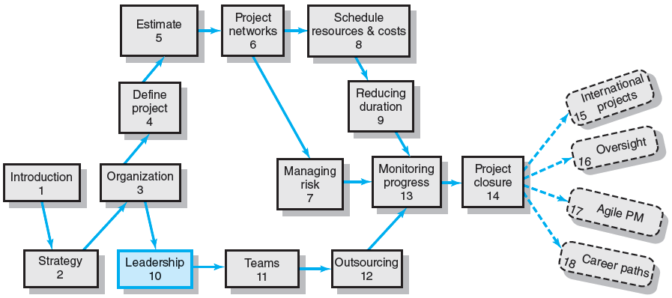
Where We Are Now
Notes:
Where Are We Now?
This chapter focuses on drawing a contrast between leadership and managerial skills, and identifies personal attributes of an effective project manager. The topics of leadership will be expanded into further discussion of managing the project team in Chapter 11 and working with people outside the organization in Chapter 12.

Slide 3
Managing versus Leading a Project
Managing—coping with complexity
Formulate plans and objectives
Monitor results
Take corrective action
Expedite activities
Solve technical problems
Serve as peacemaker
Make tradeoffs among time, costs, and project scope
Leading—coping with change
Recognize the need to change to keep the project on track
Initiate change
Provide direction and motivation
Innovate and adapt as necessary
Integrate assigned resources
Notes:
Managing vs. leading a project
A project manager copes with the complexity of managing a project by:
Formulating plans and objectives
Monitoring results for variances
Taking corrective actions
Expediting critical activities
Solving technical problems
Serving as peacemaker among conflicting project stakeholders
Make tradeoffs among time, cost, and project scope
In addition, a project manager also provides leadership in coping with changes in project elements by:
Recognizing the need for change to keep the project on track
Initiating change when necessary
Providing direction and motivation to project stakeholders
Innovating and adapting to change as necessary
Integrating assigned resources to address changes in the project

Slide 4
Managing Project Stakeholders
Project Management Maxims:
You can’t do it all and get it all done
Projects usually involve a vast web of relationships.
Hands-on work is not the same as leading.
More pressure and more involvement can reduce your effectiveness as a leader.
What’s important to you likely isn’t as important to someone else
Different groups have different stakes (responsibilities, agendas, and priorities) in the outcome of a project.
Remember: project management is tough, exciting, and rewarding—endeavor to persevere.
Notes:
Managing project stakeholders
Managing project stakeholders is important, because:
A project manager usually relies on a web of relationships to get the project done, as the project manager can’t do it all and get it all done by him/herself,
Hands-on work is not the same as leading, and
What’s important to you likely isn’t as important to someone else, because different groups have different stakes (responsibilities, agendas, and priorities) in the project’s outcome.
Therefore, perseverance is important, as project management is tough and tiring, though rewarding.

Slide 5
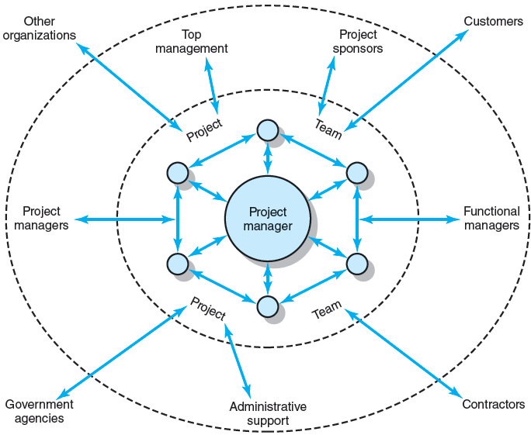
Network of Stakeholders
FIGURE 10.1
Notes:
Network of stakeholders
Figure 10.1 shows different groups of stakeholders organized in concentric circles, inside and outside the organization that can affect the project’s success. At the center is the core group of specialists (the project team and manager) assigned to complete the project. Surrounding this group are professionals who work on specific segments of the project.
Beyond this group are the groups of people within the parent organization who are either directly or indirectly involved with the project. The most notable is top management, to whom the project manager is accountable. In addition, there are also functional managers who provide resources or administrative support for the project, and possibly other project managers responsible for specific segments of the project.
External stakeholders are in the outmost ring, such as government agencies, contractors, customers, and other organizations.

Slide 6
Influence as Exchange
The Law of Reciprocity
One good deed deserves another, and likewise, one bad deed deserves another.
Quid pro Quo
Mutual exchanges of resources and services (“back-scratching”) build relationships.
Influence “Currencies” (Cohen and Bradford)
Cooperative relationships are built on the exchange of organizational “currencies” (favors).
Notes:
Influence as exchange
Mutual exchange of resources and services is a common practice to build a network of cooperative relationships, which are often viewed as organizational currencies (or favors) to be exercised in order to exert influences, among divergent allies and stakeholders.

Slide 7
Commonly Traded Organizational Currencies
Task-related currencies
Resources Lending or giving money, budget increases, personnel, etc.
Assistance Helping with existing projects or undertaking unwanted tasks.
Cooperation Giving task support, providing quicker response time, or aiding implementation.
Information Providing organizational as well as technical knowledge.
Position-related currencies
Advancement Giving a task or assignment that can result in promotion.
Recognition Acknowledging effort, accomplishments, or abilities.
Visibility Providing a chance to be known by higher-ups or significant others in the organization.
Network/ Providing opportunities for linking with others. contacts
Source: Adapted from A. R. Cohen and David L. Bradford, Influence without Authority (New York: John Wiley & Sons, 1990). Reprinted by permission of John Wiley & Sons, Inc.
TABLE 10.1
Notes:
Organizational currencies
Table 10.1 presents various kinds of commonly traded organizational currencies, relating to task, position, personal, inspiration and relationship.
Task-related currencies include the sharing of resources, assistance, cooperation and information.
Position-related currencies include advancement (giving a task or assignment that can result in advancement/promotion opportunities), recognition (acknowledging effort, accomplishment, or ability), visibility (providing a chance to be known by higher-ups in the organization), and network/contacts (opportunities for linking with others).

Slide 8
Organizational Currencies (cont’d)
Inspiration-related currencies
Vision Being involved in a task that has larger significance for the unit, organization, customer, or society.
Excellence Having a chance to do important things really well.
Ethical correctness Doing what is “right” by a higher standard than efficiency.
Relationship-related currencies
Acceptance Providing closeness and friendship.
Personal support Giving personal and emotional backing.
Understanding Listening to others’ concerns and issues.
Personal-related currencies
Challenge/learning Sharing tasks that increase skills and abilities.
Ownership/involvement Letting others have ownership and influence.
Gratitude Expressing appreciation.
Source: Adapted from A. R. Cohen and David L. Bradford, Influence without Authority (New York: John Wiley & Sons, 1990). Reprinted by permission of John Wiley & Sons, Inc.
TABLE 10.1 (cont’d)
Notes:
More organizational currencies
Here are three additional commonly traded organizational currencies.
Inspiration-related currencies include vision (from being involved in a task that has larger significance for the unit, organization, customer, or society), excellence (in having a chance to do important things really well), and ethical correctness (demonstrating what is “right” by a higher standard than efficiency).
Relationship-related currencies include acceptance (in providing closeness and friendship), personal support (through the giving of personal and emotional backing), and understanding (by listening to others’ concerns and issues).
Personal-related currencies include offering opportunities for challenge/learning (through sharing tasks that increase skills and abilities), ownership/involvement (by letting others have ownership and influence), and gratitude (by expressing appreciation).

Slide 9
Mapping network dependencies
Mapping Dependencies
Project team perspective:
Whose cooperation will we need?
Whose agreement or approval will we need?
Whose opposition would keep us from accomplishing the project?
Stakeholders’ perspective:
What differences exist between the team and those on whom the team will depend?
How do the stakeholders view the project?
What is the status of our relationships with the stakeholders?
What sources of influence does the team have relative to the stakeholders?
Notes:
Mapping network dependencies
With a social network built, the project manager needs to map network dependencies, first from the project team’s perspective by asking the following questions:
Whose cooperation will we need?
Whose agreement or approval will we need?
Whose opposition would keep us from accomplishing the project?
The project manager then needs to take the stakeholders’ perspective to ask the following questions:
What differences exist between the team and those on whom the team will depend?
How do the stakeholders view the project?
What is the status of our relationships with the stakeholders?
What sources of influence does the team have relative to the stakeholders?

Slide 10
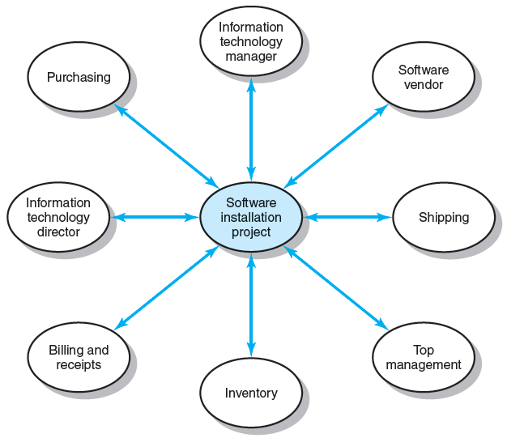
Dependencies for Financial Software Installation Project
FIGURE 10.2
Notes:
Dependencies for a financial software installation project
Figure 10.2 is a radial map of dependencies identified by the project manager responsible for installing a new financial software system in the parent company. It shows this project needs to depend on a range of stakeholders including the software vendor, top management, IT manager, inventory manager, and purchase department among others.

Slide 11
Management by Wandering Around
Management by Wandering Around (MBWA)
Involves managers spending the majority of their time in face-to-face interactions with employees building cooperative relationships.
Characteristics of Effective Project Managers
Initiate contact with key players.
Anticipate potential problems.
Provide encouragement.
Reinforce the objectives and vision of the project.
Intervene to resolve conflicts and prevent stalemates.
Notes:
Effective project management and MBWA
Management by wandering around (MBWA) is a management style in which project managers spend a majority of their time outside their office in purposeful pattern of “wandering” through the organization and engaging in face-to-face interactions that put them in touch with their project stakeholders and build cooperation essential to project success.
An effective project manager needs to:
Initiate contact with key players.
Anticipate potential problems.
Provide encouragement.
Reinforce the objectives and vision of the project.
Intervene to resolve conflicts and prevent stalemates.

Slide 12
Managing Upward Relations
Project Success = Top Management Support
Appropriate budgets
Responsiveness to unexpected needs
A clear signal to the organization of the importance of cooperation
Motivating the Project Team
Influence top management in favor of the team:
Rescind unreasonable demands
Provide additional resources
Recognize the accomplishments of team members
Notes:
Managing upward relations
Managing upward relations with top management’s support helps
Secure appropriate budgets for the project,
Gain timely response to unexpected demands, and
Send a clear signal to the organization of the importance of cooperation
In addition, project managers can motivate the project team when they demonstrate their capabilities to influence top management act in favor of the team by:
Annulling unreasonable demands,
Providing additional resources, and
Providing recognition of team members’ accomplishments.

Slide 13
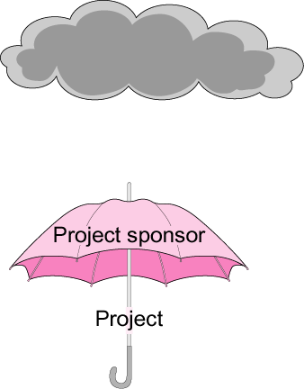
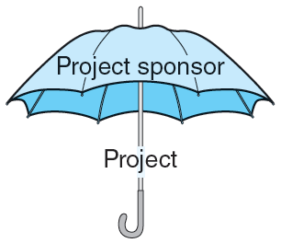
The Significance of a Project Sponsor
Upper management
FIGURE 10.3
Notes:
The significance of a project sponsor
A project may have a sponsor, who usually is a senior management, has a great interest in the project’s success, and would help shelter the project from excessive interference. Figure 10.3 shows the umbrella effect of a project sponsor who acts to defend the project when it is under attack in upper circles of management and others. So the project manager should always keep the sponsor first informed of any problems that may cause embarrassment or disappointment.

Slide 14
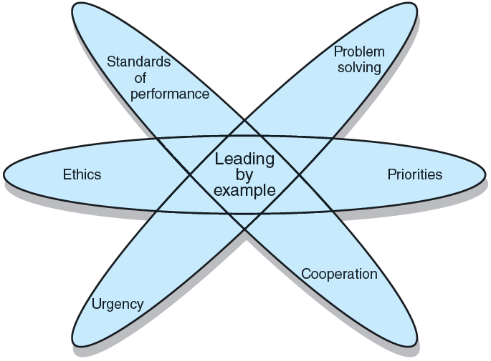
Leading by Example
FIGURE 10.4
Notes:
Leading by example
Figure 10.4 illustrates that an effective project manager must “walk the talk” and lead by example, in many aspects of project management such as setting priorities, acting in cooperation with others, conveying a sense of urgency, solving problems, responding ethically to dilemmas, and setting high standards of performance for oneself and others. Leading by example is a highly visible, interactive management style and a powerful leadership tool.

Slide 15
Ethics and Project Management
Ethical Dilemmas
Situations where it is difficult to determine whether conduct is right or wrong:
Padding of cost and time estimations
Exaggerating pay-offs of project proposals
Falsely assuring customers that everything is on track
Being pressured to alter status reports
Falsifying cost accounts
Compromising safety standards to accelerate progress
Approving shoddy work
Code of conduct
Professional standards and personal integrity
Notes:
Ethics and project management
A project manager may encounter ethical dilemmas where it is difficult to determine if conduct is right or wrong throughout the duration of a project. Below are situations that may confront project managers:
Padding of cost and time estimations
Exaggerating pay-offs of project proposals
Falsely assuring customers that everything is on track
Being pressured to alter status reports
Falsifying cost accounts
Compromising safety standards to accelerate progress
Approving shoddy work
Organizations can help their employees deal with ethical dilemmas by developing a code of conduct that defines the organization’s standards for professional behaviors and personal integrity.

Slide 16
Contradictions of Project Management
Innovate and maintain stability.
See the big picture while getting your hands dirty.
Encourage individuals but stress the team.
Hands-off/Hands-on.
Flexible but firm.
Team versus organizational loyalties.
Notes:
Contradictions of project management
An effective project manager has to be able to deal with the contradictory nature of project management. Dealing with those contradictions requires managers to:
Innovate and yet maintain stability simultaneously.
See the big picture while getting your hands dirty with the details.
Encourage individuals to perform but stress the team goals.
Know when to be hands-off or hands-on.
Be adaptively flexible but firm about standards.
Avoid fostering team versus organizational loyalties.

Slide 17
Traits of an Effective Project Manager
Systems thinker
Personal integrity
Proactive
High emotional intelligence (EQ).
General business perspective
Effective time management
Skillful politician
Optimist
Notes:
Traits of an effective project manager
An effective project manager must:
Be a systems thinker
Be a skillful politician
Be an optimist
Be proactive rather than reactive
Has a general business perspective
Has a strong sense of personal integrity
Has a high emotional intelligence (EQ), and
Manages time effectively.

Slide 18
Suggestions for Project Managers
Build relationships before you need them.
Trust is sustained through frequent face-to-face contact.
Realize that “what goes around comes around.”
Notes:
Suggestions for project managers
A successful project manager must:
Believe that “what goes around comes around.”
Build relationships before they are needed.
Understand that trust is built and sustained through frequent face-to-face contact.

Slide 19
Key Terms
Emotional intelligence (EQ)
Inspiration-related currencies
Law of reciprocity
Leading by example
Management by wandering around (MBWA)
Personal-related currencies
Position-related currencies
Proactive
Relationship-related currencies
Social network building
Stakeholder
Systems thinking
Task-related currencies
Notes:
Key terms
Summarized below are key terminology covered in this chapter, including emotional intelligence (EQ).
Emotional intelligence (EQ) is the ability or skill to perceive, assess, and manage the emotions of one’s self and others.
Inspiration-related currencies are based on inspiration (opportunity to do good, be the best, etc.).
Law of reciprocity states that people are obligated to grant a favor comparable to the one they received.
Leading by example requires exhibiting the behaviors you want to see in others.
Management by wandering around (MBWA) is a management style in which managers spend the majority of their time outside their offices interacting with key people.
Personal-related currencies are influence based on enhancing another person’s self-esteem.
Position-related currencies are influence based on the ability to enhance someone else’s position within an organization.
Proactive describes working within your sphere of influence to accomplish something.
Relationship-related currencies Influence based on friendship.
Social network building is the process of identifying and building cooperative relationships with key people.
Stakeholders are individuals and organizations that are actively involved in the project, or whose interests may be positively or negatively affected as a result of project execution or completion and who may also exert influence over the project and its results.
Systems thinking is a holistic approach to viewing problems that emphasizes understanding the interactions among different problem factors.
Task-related currencies is influence based, helping someone else do their work.

